Slide 1
Unit 9.2
Learning Objectives
A Real world Application of Databases
The Money Ball Example
Data Warehouses
The Role of Data Warehouses
Group Exercise
Database access from code
Database Cycle Review
SQL Command Types
Group Exercise on SELECT (Unit 9.1)
INSERT, UPDATE, DELETE
Putting it all together: Execution
Hands on Activity

Slide 2


Slide 3

How Data can be used
Baseball Stats
Batting average
Stolen bases
Runs batted in
On-base %
Slugging %
On-base + Slugging (OPS)

Slide 4
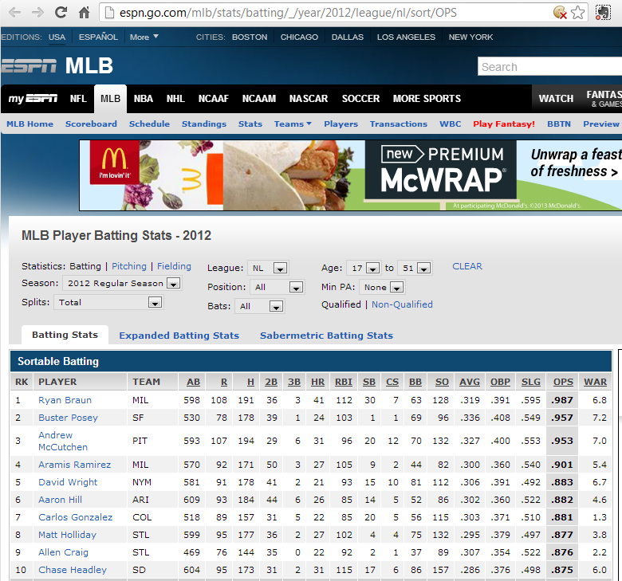

Slide 5
Databases
Database creation and use
MS Visual Web Developer
Database and Query Development
MS SQL Server
Business Intelligence
Microsoft BI, IBM Cognos
Real world Application
Money Ball

Slide 6
Data warehouses
Please answer the following questions based on Intricity’s Video on Benefits of a Data Warehouse
What is a Data Warehouse?
What is the impact of the fact that databases can take in one row of data at a time?
When the video says “You are doing it anyway, what is it talking about?”
List any two benefits of data warehousing.

Slide 7
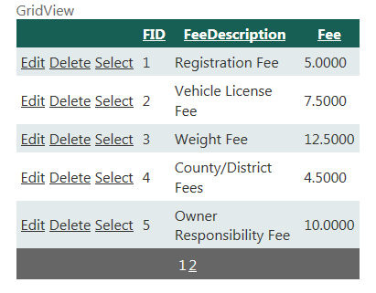
Accessing Data
SQL DataSource
-Connection
-Command
csFees…connectionString
cmdFees…SQLcommand
Browser e.g. FireFox
Web server
e.g. Windows
Server
Database server
e.g. MS SQL Server
HTML
ASPX
SQL
lblOutput.Text= myReader[0].Text
["1",“Registration Fee",5.00,”2”, “Vehicle License Fee",7.5,”3”, “Weight Fee“, 12.500]
Views

Slide 8
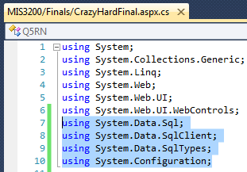
The Five Grand Steps to Database Access in Code
Get READY
Add namespaces
WHERE the database is
Create a Connection String (name, path)
WHAT needs to be done
Create a Command Object (SQL)
EXECUTE!
Execute the Command and output data stream into a Reader
Loop through the Reader and read the data
csFees
myCommand
For commands that do not CHANGE the database
"1",“Registration Fee",5.00, ”2”, “Vehicle License Fee",7.50, ”3”, “Weight Fee“, 12.50
Notes:
GUI controls allow us to do a great deal but they can’t do everything
.NET provides a number of objects that allow us to perform database manipulation in code
The database objects are collected into three Namespaces
A namespace is a way to uniquely identify a set of programming objects

Slide 9




SQL Command Types
Based on whether or not they AFFECT the database
SELECT
INSERT, UPDATE, or DELETE
Images source: artistitvalley.com

Slide 10
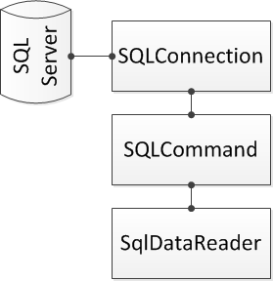
Handling SELECT commands
SELECT commands output data
Temporary holder: SqlDataReader
The reader needs to be looped through
SqlConnection myConnection = new SqlConnection(strConnection);
SqlCommand myCommand = new SqlCommand(strSql, myConnection);
SqlDataReader myReader = myCommand.ExecuteReader();

Slide 11
Group Exercise
string strConnection = ConfigurationManager.ConnectionStrings["cs3200"].ToString();
SqlConnection myConnection = new SqlConnection(strConnection);
string strSql = "SELECT [FeeDescription], [Fee] FROM Fees ORDER BY [FeeDescription]";
SqlCommand myCommand = new SqlCommand(strSql, myConnection);
myConnection.Open();
SqlDataReader myReader = myCommand.ExecuteReader();
while (myReader.Read())
{
string strDescription = myReader[“FeeDescription”].ToString();
decimal decFee = Convert.ToDecimal(myReader[“Fee”]);
lblFees.Text += strDescription + " at " + decFee.ToString("C2") + "<br/>";
}
myReader.Close();
myConnection.Close();

Slide 12
INSERT commands
Adds new records to the database
Syntax:
Best Practices
Include the primary key, unless the primary key is an Identify
Include all fields that don’t allow nulls & have default values
Include any foreign keys
Ensure data to be in the correct data type
INSERT INTO tableName (list_of_fields) VALUES (list_of_values)
comma separated, enclosed in [ ]
in the same order as fields

Slide 13
UPDATE Commands
Used to modify existing database records
Syntax
Best Practice:
Don’t update the primary key
Use the primary key to Identify a single record
Ensure compliance with records that don’t allow nulls
Ensure compliance with foreign keys
Not using a WHERE clause will update all records in the table
If no records are updated, it is because no records qualified
UPDATE tableName SET field1=value1 [, …] WHERE fieldX =Y
One or more values
Which record to update

Slide 14
DELETE Commands
Used to remove records from the database
Syntax
Best Practice:
Omitting the WHERE clause will delete all records in the table
If no records are deleted, it is because no records qualified
Cannot delete records on the ONE side of a 1-to-many relationship
Always confirm a delete actions
DELETE FROM tableName WHERE condition

Slide 15
The Execution - Step #4
Use .ExecuteNonQuery(), instead of .ExecuteReader()
Syntax:
Best Practice:
Syntax for the command and connection object are unchanged
In SQL: use parameters for any data coming from TextFields
Assign values to the parameters
Counter estimates whether the command was successful
Question: What if intCnt =0?
int intCnt = myCommand.ExecuteNonQuery();
Number of records affected

Slide 16
Execution i.e. Step #4 (in Code)
1
2
string strConnection = ConfigurationManager.ConnectionStrings["cs3200"].ToString();
SqlConnection myConnection = new SqlConnection(strConnection);
string strSql= "INSERT INTO OUCourses (CName,CNum,CHrs) VALUES (@CName, @CNum, @CreditHrs)";
SqlCommand myCommand = new SqlCommand(strSql, myConnection);
string strCName = txtCName.Text;
myCommand.Parameters.Add("@CName", System.Data.SqlDbType.NVarChar, 50).Value = strCName;
int intCNum = Convert.ToInt32(txtHrs.Text);
myCommand.Parameters.Add("@CNum", System.Data.SqlDbType.int).Value = intCNum;
int intHrs = Convert.ToInt32(txtHrs.Text);
myCommand.Parameters.Add("@CreditHrs", System.Data.SqlDbType.int).Value = intHrs;
int intCnt =-1
myConnection.Open();
int intCnt = myCommand.ExecuteNonQuery();
if (intCnt = 0)
lblInsert.Text = “One Records was added";
Else
lblInsert.Text = “No records were added";
myConnection.Close();
3a
3b
4

Slide 17
L2: Hands-on
For this exercise we are going to add new fees to the fee table using code
Create a new page in your Unit9 folder and call it lastNameU9L2.aspx
Be sure that “Please code in separate file” and “Select master page” are checked
Add your name and assignment information to the page title
Add the following H2 heading to the page
INSERTING AND UPDATING DATA FROM CODE

Slide 18
U9L2 - 2
Under the H2 heading and an H3 heading
THE FOLLOWING FEES ARE CURRENTLY RECORDED:
Add a GridView under the H3 heading
Create a SQL DataSource for the GridView
Select the fees table you created in Unit8
Select both the FeeDescription and the Fee fields
No WHERE and no Advanced features
Select a nice format for the GridView and add a Select link (we won’t use it in this exercise but we will use it in U9L2.2)

Slide 19
U9L2 - 3
Below the DataSource, add an H3 title that says
ADD A NEW FEE:
Below that add
The text “New Fee Description”
A TextBox named txtFeeDescription
A required field validator
Below that add
The text “New Fee:”
A TextBox named txtFee
A required field validator
Another validator to make sure the number is a positive decimal number

Slide 20
U9L2 - 4
Below that add a button
Change the name to btnAdd
Change the text to Add new fee
Below the button and a Label named lblIsert
Below the button and a validation summary
Put all the validators, the button and the validation summary in the same validation group
Set the validation summary to use the popup window

Slide 21
U9L2 - 5
Double click the button to create a method
Add the database and configuration namespaces at the top of the page
Create a connection object in the new method (exactly the same as in the Unit8 exercises)
Create a string with the following SQL statement
Create a new command object using this SQL string and your connection object
Add parameters to the command object that assign values to the two parameters used in the SQL
This works exactly the same was as what you did to create a WHERE clause parameter in Unit 8

Slide 22
U9L2 - 6
Create a try/catch block
Inside the try
Open the connection
Enter the following line of code
On the following line, check to see if intCnt is >1 (that means that at more than one record was inserted)
If that is true, display the value of intCnt and a message saying “ records were added”
If intCnt isn't’ > 1, display a message saying that one record was inserted
Close the connection
Close the try block

Slide 23
U9L2 - 7
Write the catch statement in the form
Inside the catch block, write a message to the label saying you were unable to insert the record and then display the standard Exception message found in ex.Message
Close the catch block
Close the connection again (in case there was an exception)
Databind the GridView
Set the SelectedIndex of the GridView to -1
Clear the text boxes

Slide 24
U9L2 - 8
Test your page to be sure you can insert new fees
Link the page to your portfolio page
Upload your ASPPub to ASPNET
Put a link to your portfolio page in the dropbox AFTER you test to be sure that everything still works correctly on ASPNET

