Slide 1
Unit 9.2:
Learning Objectives
Agile Development
  Bruce Feiler on Agile Programming
Database access from code
  Database Cycle Review
  SQL Command Types
  Group Exercise on SELECT (Unit 9.1)
  INSERT, UPDATE, DELETE
  Putting it all together: Execution
  Hands on Activity

Slide 2
Agile Programming
Based on Bruce Feiler’s video, list at least five characteristics on Agile Programming

Slide 3
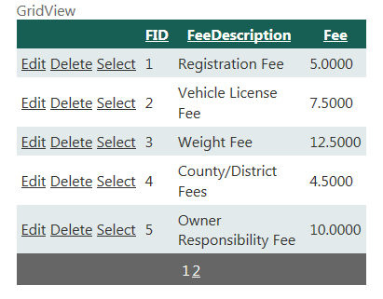
Accessing Data
SQL DataSource
-Connection
-Command
csFees…connectionString
cmdFees…SQLcommand
Browser
e.g. FireFox
Web server
e.g. Windows
Server
Database server
e.g. MS SQL Server
HTML
ASPX
SQL
lblOutput.Text=
myReader[0].Text
["1",“Registration Fee",5.00,”2”, “Vehicle License Fee",7.5,”3”, “Weight Fee“, 12.500]
Views

Slide 4
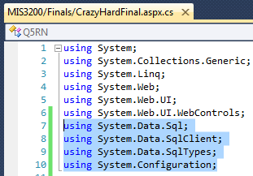
The Five Grand Steps to Database Access in Code
  Get READY
    Add namespaces
  WHERE the database is
    Create a Connection String (name, path)
  WHAT needs to be done
    Create a Command Object (SQL)
  EXECUTE!
    Execute the Command and output data stream into a Reader
  Loop through the Reader and read the data
csFees
myCommand
For commands that
do not CHANGE the database
"1",“Registration Fee",5.00,
”2”, “Vehicle License Fee",7.50,
”3”, “Weight Fee“, 12.50
Notes:
GUI controls allow us to do a great deal but they can’t do everything
.NET provides a number of objects that allow us to perform database manipulation in code
The database objects are collected into three Namespaces
A namespace is a way to uniquely identify a set of programming objects

Slide 5




SQL Command Types
Based on whether or not they AFFECT the database
  SELECT
  INSERT, UPDATE, or DELETE
Images source: artistitvalley.com

Slide 6
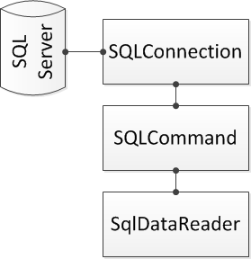
Handling SELECT commands
SELECT commands output data
Temporary holder: SqlDataReader
The reader needs to be looped through
SqlConnection myConnection = new SqlConnection(strConnection);
SqlCommand myCommand = new SqlCommand(strSql, myConnection);
SqlDataReader myReader = myCommand.ExecuteReader();

Slide 7
Group Exercise
string strConnection = ConfigurationManager.ConnectionStrings["cs3200"].ToString();
SqlConnection myConnection = new SqlConnection(strConnection);
string strSql = "SELECT [FeeDescription], [Fee] FROM Fees ORDER BY [FeeDescription]";
SqlCommand myCommand = new SqlCommand(strSql, myConnection);
  myConnection.Open();
SqlDataReader myReader = myCommand.ExecuteReader();
while (myReader.Read())
{
string strDescription = myReader[“FeeDescription”].ToString();
decimal decFee = Convert.ToDecimal(myReader[“Fee”]);
lblFees.Text += strDescription + " at " + decFee.ToString("C2") + "<br/>";
}
myReader.Close();
myConnection.Close();

Slide 8
INSERT commands
Adds new records to the database
Syntax:
Best Practices
  Include the primary key, unless the primary key is an Identify
  Include all fields that don’t allow nulls & have default values
  Include any foreign keys
  Ensure data to be in the correct data type
  INSERT INTO tableName (list_of_fields) VALUES (list_of_values)
  comma separated, enclosed in [ ]
  in the same order as fields

Slide 9
UPDATE Commands
  Used to modify existing database records
  Syntax
  Best Practice:
  Don’t update the primary key
  Use the primary key to Identify a single record
  Ensure compliance with records that don’t allow nulls
  Ensure compliance with foreign keys
  Not using a WHERE clause will update all records in the table
  If no records are updated, it is because no records qualified
  UPDATE tableName SET field1=value1 [, …] WHERE fieldX =Y
  One or more values
  Which record to update

Slide 10
DELETE Commands
Used to remove records from the database
Syntax
Best Practice:
  Omitting the WHERE clause will delete all records in the table
  If no records are deleted, it is because no records qualified
  Cannot delete records on the ONE side of a 1-to-many relationship
  Always confirm a delete actions
  DELETE FROM tableName WHERE condition

Slide 11
The Execution - Step #4
Use .ExecuteNonQuery(),
instead of .ExecuteReader()
Syntax:
Best Practice:
  Syntax for the command and connection object are unchanged
  In SQL: use parameters for any data coming from TextFields
  Assign values to the parameters
  Counter estimates whether the command was successful
  Question: What if intCnt =0?
  int intCnt = myCommand.ExecuteNonQuery();
  Number of records affected

Slide 12
Execution i.e. Step #4 (in Code)
1
2
string strConnection = ConfigurationManager.ConnectionStrings["cs3200"].ToString();
SqlConnection myConnection = new SqlConnection(strConnection);
string strSql= "INSERT INTO OUCourses (CName,CNum,CHrs) VALUES (@CName, @CNum, @CreditHrs)";
SqlCommand myCommand = new SqlCommand(strSql, myConnection);
string strCName = txtCName.Text;
myCommand.Parameters.Add("@CName", System.Data.SqlDbType.NVarChar, 50).Value = strCName;
int intCNum = Convert.ToInt32(txtHrs.Text);
myCommand.Parameters.Add("@CNum", System.Data.SqlDbType.int).Value = intCNum;
int intHrs = Convert.ToInt32(txtHrs.Text);
myCommand.Parameters.Add("@CreditHrs", System.Data.SqlDbType.int).Value = intHrs;
int intCnt =-1
myConnection.Open();
int intCnt = myCommand.ExecuteNonQuery();
if (intCnt = 0)
lblInsert.Text = “One Records was added";
Else
lblInsert.Text = “No records were added";
myConnection.Close();
3a
3b
4

Slide 13
L2: Hands-on
For this exercise we are going to add new fees to the fee table using code
  Create a new page in your Unit9 folder and call it lastNameU9L2.aspx
    Be sure that “Please code in separate file” and “Select master page” are checked
    Add your name and assignment information to the page title
  Add the following H2 heading to the page
    INSERTING AND UPDATING DATA FROM CODE

Slide 14
U9L2 - 2
  Under the H2 heading and an H3 heading
    THE FOLLOWING FEES ARE CURRENTLY RECORDED:
  Add a GridView under the H3 heading
  Create a SQL DataSource for the GridView
    Select the fees table you created in Unit8
    Select both the FeeDescription and the Fee fields
    No WHERE and no Advanced features
  Select a nice format for the GridView and add a Select link (we won’t use it in this exercise but we will use it in U9L2.2)

Slide 15
U9L2 - 3
  Below the DataSource, add an H3 title that says
    ADD A NEW FEE:
  Below that add
    The text “New Fee Description”
    A TextBox named txtFeeDescription
    A required field validator
  Below that add
    The text “New Fee:”
    A TextBox named txtFee
    A required field validator
    Another validator to make sure the number is a positive decimal number

Slide 16
U9L2 - 4
  Below that add a button
    Change the name to btnAdd
    Change the text to Add new fee
  Below the button and a Label named lblIsert
  Below the button and a validation summary
    Put all the validators, the button and the validation summary in the same validation group
    Set the validation summary to use the popup window

Slide 17
U9L2 - 5
Double click the button to create a method
  Add the database and configuration namespaces at the top of the page
  Create a connection object in the new method (exactly the same as in the Unit8 exercises)
  Create a string with the following SQL statement
  Create a new command object using this SQL string and your connection object
  Add parameters to the command object that assign values to the two parameters used in the SQL
This works exactly the same was as what you did to create a WHERE clause parameter in Unit 8

Slide 18
U9L2 - 6
  Create a try/catch block
  Inside the try
    Open the connection
    Enter the following line of code
    On the following line, check to see if intCnt is >1 (that means that at more than one record was inserted)
      If that is true, display the value of intCnt and a message saying “ records were added”
      If intCnt isn't’ > 1, display a message saying that one record was inserted
    Close the connection
    Close the try block

Slide 19
U9L2 - 7
  Write the catch statement in the form
  Inside the catch block, write a message to the label saying you were unable to insert the record and then display the standard Exception message found in ex.Message
  Close the catch block
  Close the connection again (in case there was an exception)
  Databind the GridView
  Set the SelectedIndex of the GridView to -1
  Clear the text boxes

Slide 20
U9L2 - 8
  Test your page to be sure you can insert new fees
  Link the page to your portfolio page
  Upload your ASPPub to ASPNET
  Put a link to your portfolio page in the dropbox AFTER you test to be sure that everything still works correctly on ASPNET

