Slide 1
Maria Yee Inc. Joining Financial growth with environmental Responsibility
Katie Bennett and Gina Ciavarro

Slide 2
Introduction to Maria Yee Inc.
Unrivaled
Craftsmanship
Environmental Responsibility
Exquisite Design
Notes:
In the intro discuss Maria Yee Inc. as a company a bit and get at the economy & environment piece.

Slide 3
Current Issue
Maria Yee Inc. is currently facing the challenge of building their business in a weak economy, while still staying true to her eco-friendly ideals.

Slide 4
Supply Chain

Slide 5
Supply Chain Goals and Solutions
Reduce Carbon Emissions
Reduce Internal Costs
Cooperative Shipping
Purchase Carbon Offsets

Slide 6
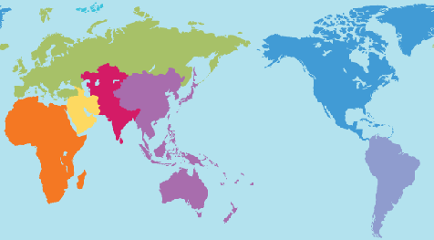
Cooperative Shipping
Aligning inbound and outbound shipments in conjunction with another manufacturer.
Notes:
Because: Save on freight costs, negotiate better rates, and reduce Greenhouse Gas Emissions

Slide 7
Guangzhou Limen Furniture Co., Ltd.
Location, Location, Location
Non-Competitor
Green Oriented, People Focused
Notes:
Talk about their qualities

Slide 8
Purchasing Carbon Offsets
Carbon offsets are a financial instrument aimed at a reduction in greenhouse gas emissions.
=
The Reduction of
1
1
Carbon
Offset
Metric Ton of CO₂

Slide 9
Purchasing Carbon Offsets
Focus on strengths
Save money on a full scale solution
Use as a marketing tool
Notes:
Because: Purchasing carbon offsets would allow Maria Yee Inc. to continue to do what they do best, which is the designing and manufacturing of high-quality luxurious eco-friendly furniture, and not have to invest in a full scale supply chain management solution.
How: Find a reputable source from which these offsets can be purchased, then advertise it!

Slide 10
Marketing

Slide 11
Marketing Goals and Solutions
Capitalize on Market Trends
Differentiate from Competition
Utilize Green Marketing
Enhance Website Design

Slide 12
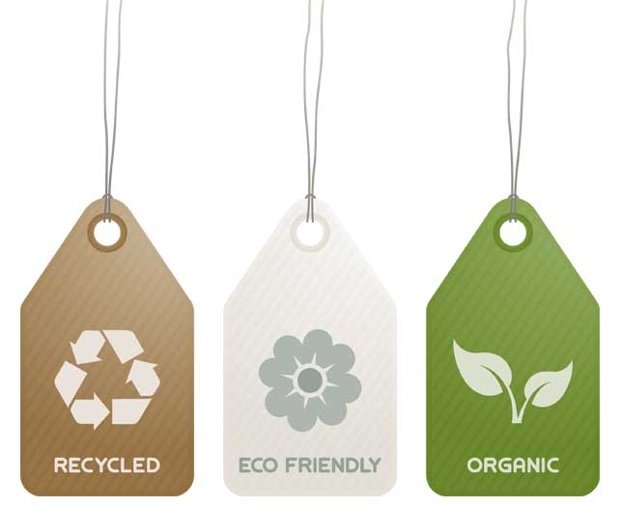
Green Marketing
Marketing that highlights an organization's environmentally friendly policies or achievements

Slide 13

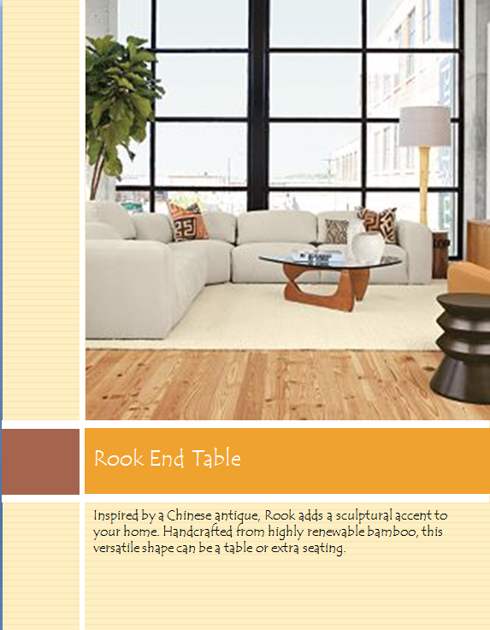
Retail Level Marketing
Retailers should make marketing materials available
View books, informational tags

Slide 14
Website
Certifications should be prominently listed
Online media is the most important place for brand image to be established, defended and grown

Slide 15
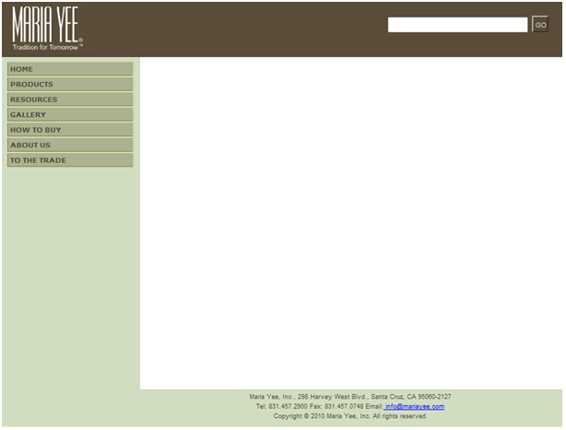





Website Mockup
Twenty Years of EcoLuxury™

Slide 16
Branding

Slide 17
Branding Goals and Solutions
Build Customer Loyalty
Develop Designer Recognition
Retail Venues Advertise Name
Rename Pieces After Maria Yee
Add a Signature Detail

Slide 18
Signature Detail
This will be an identifiable detail on each piece of furniture
Alludes to sustainability and Chinese inspiration
Representative of her design aesthetic

Slide 19


Signature Detail Example

Slide 20
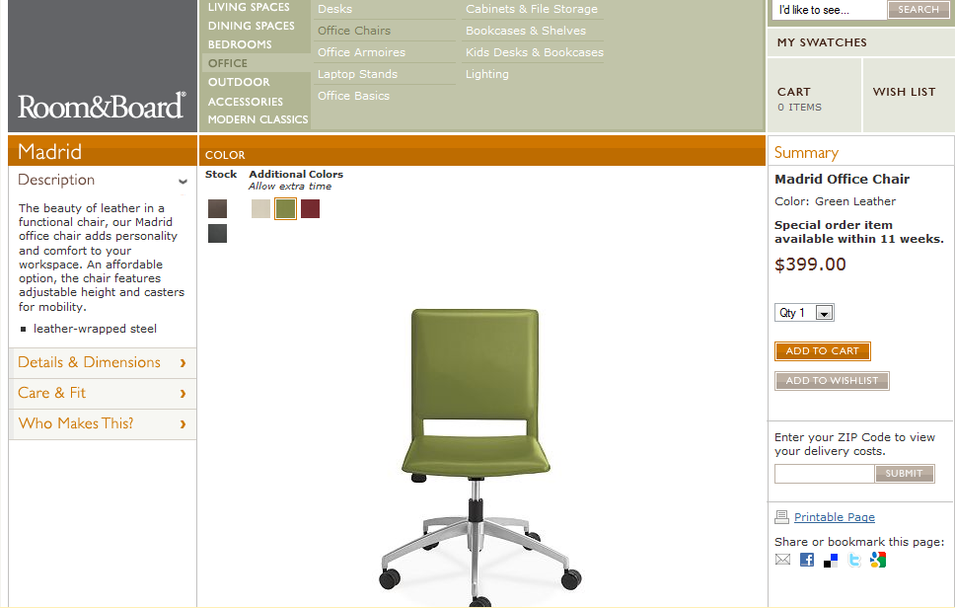
Rename Maria Yee Pieces

Slide 21
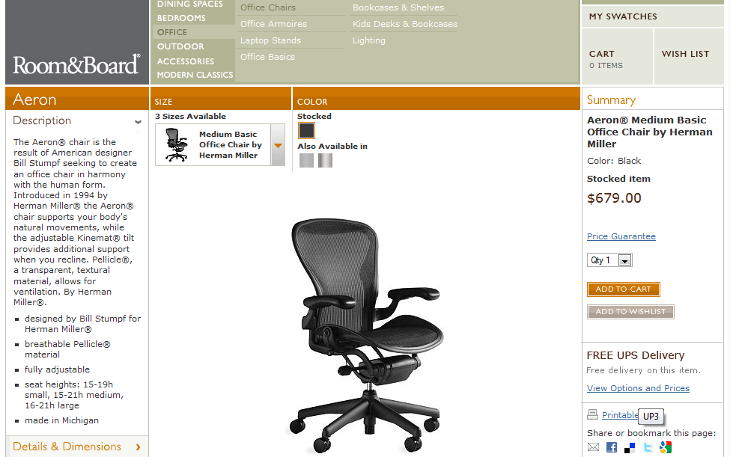
Herman Miller

Slide 22
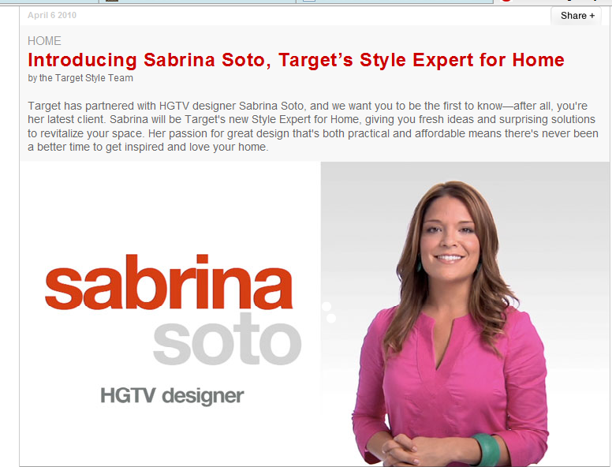
Target Model

Slide 23
Conclusion

Slide 24
The strategy we have outlined will allow Maria Yee Inc. to lead the green wave in the furniture industry while remaining profitable.
Supply Chain
Cooperative Shipping
Carbon Offsets
Marketing
Marketing Materials
Website
Branding
Signature Detail
Designer Focused

