Slide 1
Management Information Systems (MIS)
Ohio University

Slide 2
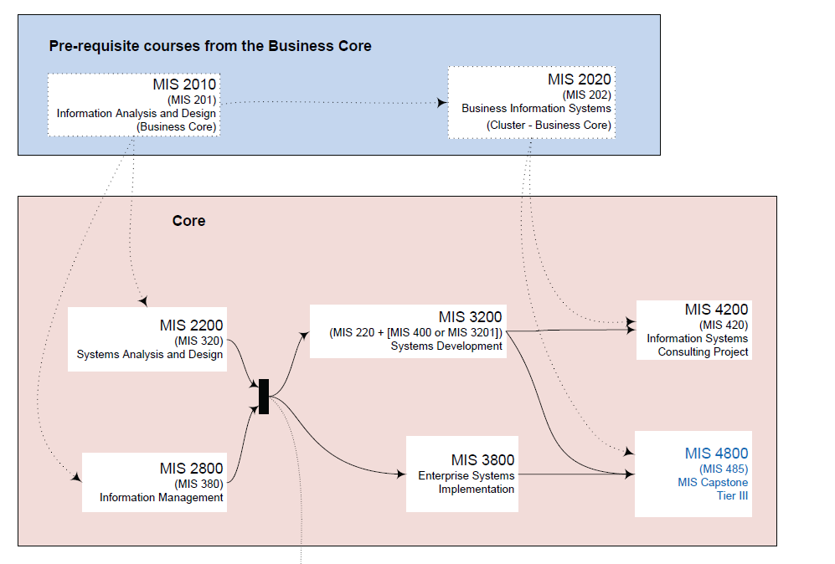
The MIS Major in 3 Semesters.

Slide 3
MIS is an excellent double major.
Information Systems Focus in all Business Disciplines:
Accounting + MIS = Enterprise Accounting Information Systems
Finance + MIS = Enterprise Financial Reporting Systems
Marketing + MIS = Customer Relationship Management Systems
Management + MIS = Business Intelligence, Collaboration and
Supply Chain Management Systems

Slide 4
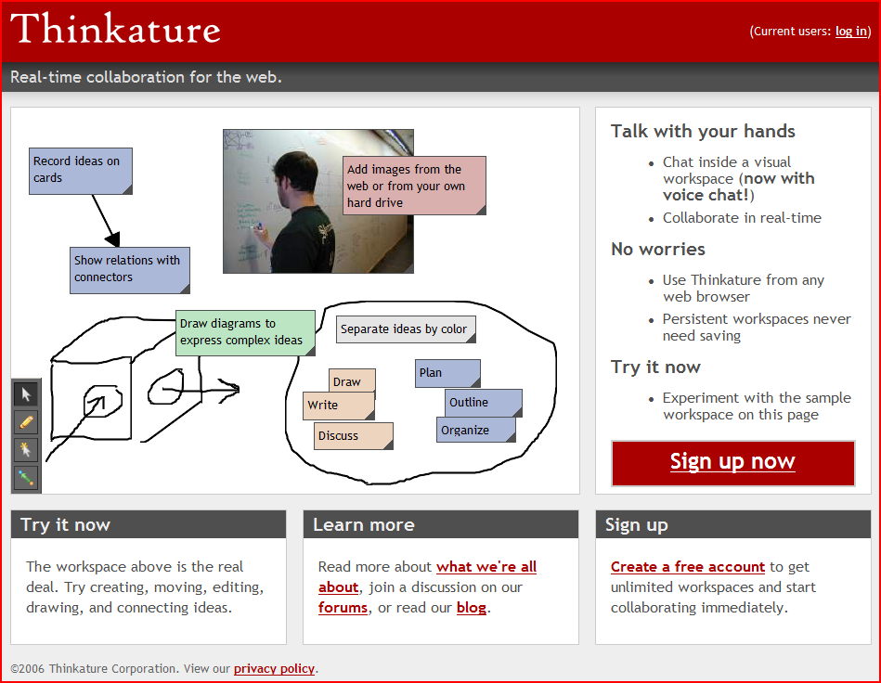
MIS professionals lead change & innovation in business.
We build the future of how work is done…

Slide 5
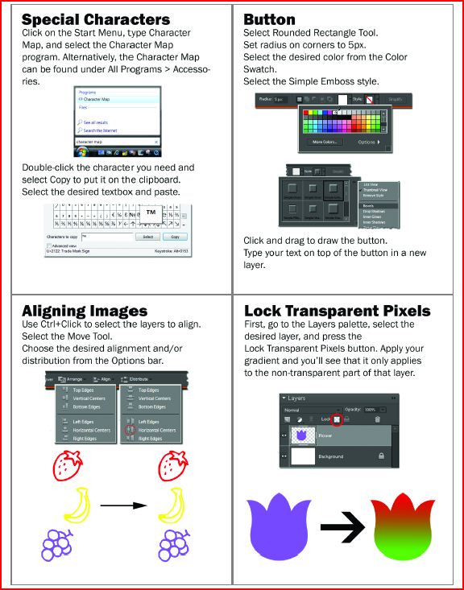

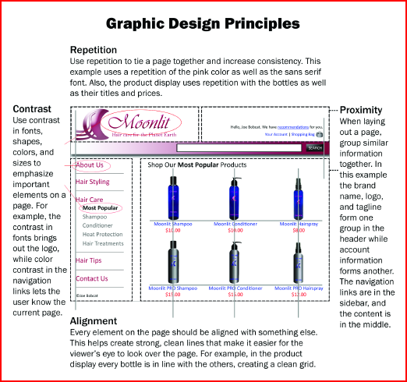
Our faculty constantly innovate.
We write the book!
Source: MIS201B Course Material by Professor Raymond Frost

Slide 6
You get real world skills, knowledge, and experience.
We teach you HOW information systems work is done…
Analysis
Req’ts
Definition
Design
Development
Implement

Slide 7
What is Information Systems
People
Business Communication!
Business Strategy
Problem and Opportunity Areas
IS
Processes
IT

Slide 8
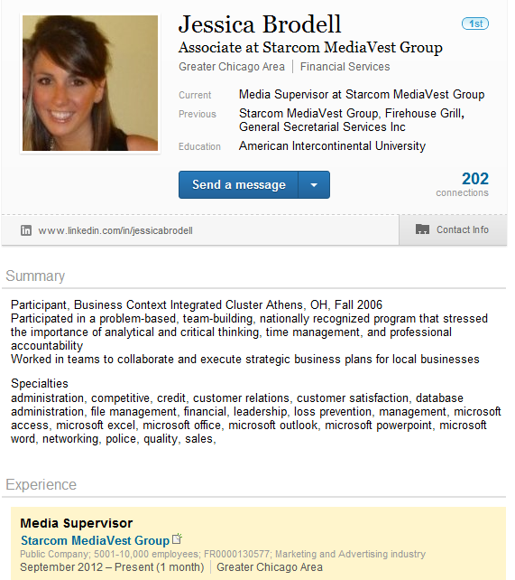
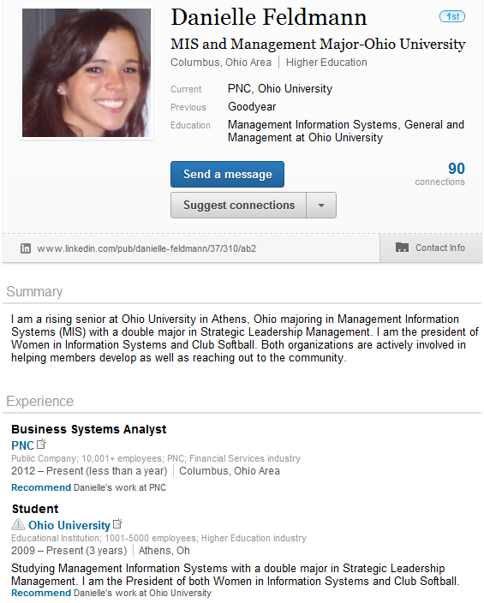
MIS Professionals

Slide 9
4. The job market is strong!
Career | Projected growth & need(2004-2014) | Median wages (2005)
Application Developer | Much faster than average (36+%) | $77,090 annual
Information Security Manager | Much faster than average (36+%) | $59,930 annual
IS Manager | Faster than average (21-35%) | $96,520 annual
Project Manager | Faster than average (21-35%) | $96,520 annual
Systems Analyst | Faster than average (21-35%) | $68,300 annual
Web Designer | Average (10-20%) | $59,420 annual;
Systems Auditor | Faster than average (21-35%) | $68,300 annual
Source: U.S. Bureau of Labor Statistics

Slide 10
1. Average salaries top the $60K mark!
Source: NACEweb.org

Slide 11
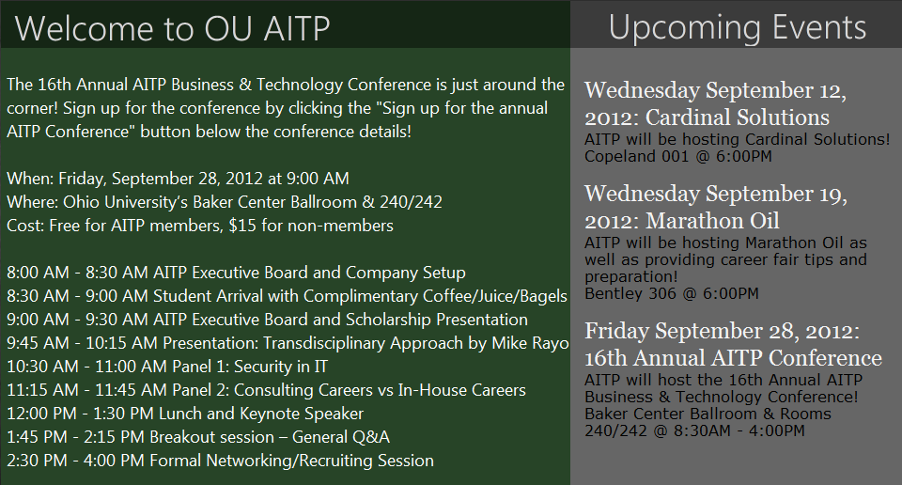
Build your network with AITP.

Slide 12
Top 10 Reasons to Major In MIS
Complete the major in three semesters.
9. Our exclusive “99% no close-out guarantee!”.
8. MIS is an excellent double major.
7. It’s exciting! MIS professionals lead change and innovation in business.
6. Our faculty constantly innovate in the classroom.
5. You get real world skills, knowledge, and experience.
4. The job market is strong!
3. You are not alone in your internship/job search.
2. Build your network with AITP.
1. Starting salaries push the $50K mark in 2008!

Slide 13
The MIS Major in 3 Semesters.

