Slide 1
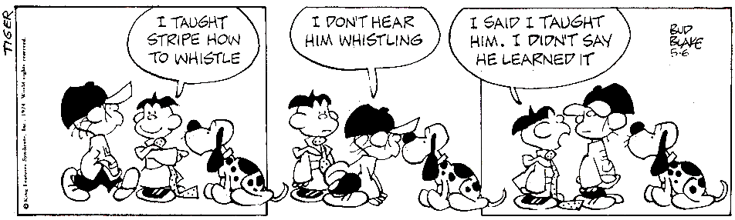
How to structure Class Preparation Assignments that really work so that your students come to class prepared and ready to engage the material
Vic Matta

Slide 2
Agenda
Outline of a CPA
Why CPAs
Examples of CPAs
CPA ≠ HW
References

Slide 3
An outline of a CPA
A homework assignment
facilitates familiarity of concepts for next class
Low impact on grades
Typically written
Always credited
Always discussed

Slide 4
Why CPAs
Lecturing is medieval (Yamane, 2006)
To get students to prepare for class
Allows for active learning to happen
Increased learning due to involved students
Students like it more, feel more responsible
It beats facebooking in a lab class.

Slide 5
Why students like it
It suggests what is important
It forces preparation, versus classes that suggest “reading the chapter”
Less time wasted – staring
Levels the playing field – weaker students
Shy kids
Elaborate / build

Slide 6
Elements of a CPA
CPA Ch. 18
Introduction: Project Management is the application of knowledge, skills, tools, and techniques to project activities in order to meet or exceed stakeholder needs and expectations from a project
Objective: To Review principles of Project Management
Go to: Backboard → Connect → Ch. 18
1. What are the three primary variables (or triple constraints) in any project?
Time, expense, requirements
Time, cost, expense
Time, cost, quality
Time, cost, scope
2. …
Introductory Statement
Objective
Information or its source
The assignment itself

Slide 7
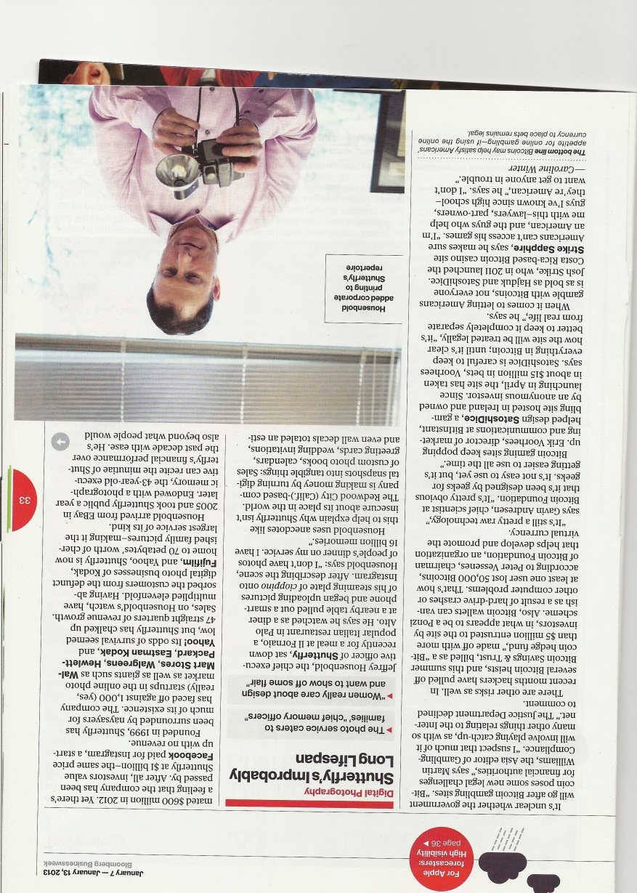
CPA #2
Introduction:
Shutterfly, a photo service, faced against 1000 startups in the online photo service …
Objective:
Use Value Chain Analysis to explain how Shutterfly created value & sustained 47 quarters of revenue growth.
References:
Textbook Ch. 2: Value Chain
Value Chain (MindTools website)
Business Week on Shutterfly

Slide 8
CPA ≠ HW
Purpose: class preparation
Typically credit/no credit
Accountability
Read the chapter
Cognitive component ≠ busy work
Students: identify difficulties
Teachers: build on it

Slide 9
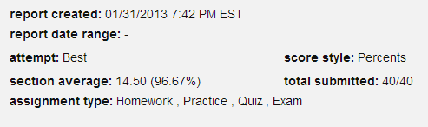
Experimental CPAs
MIS 202: “Read the chapter, we’ll discuss this in class, there’s a quiz” (95% completed, 2/3rd students participated)
MIS2020: No announcement, Quiz shows on schedule (90% completed, 1/2 students participated)
MIS 2020: “Multiple Choice CPA assigned” (100% completed, perfect scores)
MIS 3200: every alternate class “Complete steps to develop a web page” (100% completed, high scores)

Slide 10
References .. And what’s in them
Gillette, L., Davis, K., 2012, How to Ensure that Students Prepare for Class so that Class Time can be used for Deep Learning, 32nd Lilly International Conference on College Teaching, Miami, OH
A succinct four page outline for a CPA
Yamane, D., 2006, Course Preparation Assignments: A Strategy for Creating Discussion-based Courses, Teaching Sociology, Vol. 34, 2006
A full-scale, well written 12 page paper on What-Why-Hows of CPAs
Anonymous, Getting Students to Prepare for Class, Teaching and Learning Center, University of Oregon
Another perspective, short (two pages).

