Slide 1
Ch. 3: Strategic Initiatives for Implementing Competitive Advantages
SCM
CRM
BPR
ERP

Slide 2
Learning Outcomes: to explain …
Supply Chain Management (SCM) & its role in business
Customer Relationship Management (CRM) systems & how they can help firms understand customers
Importance of Enterprise Resource Planning (ERP) systems
How an organization can use Business Process Reengineering (BPR) to improve its business

Slide 3
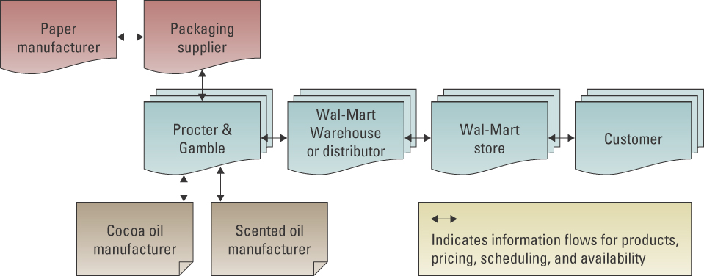
Supply Chain Management
  It involves the management of information between and among stages in a supply chain to maximize total supply chain effectiveness and profitability
  Supply chain strategy
  Supply chain partner
  Supply chain operation
  Supply chain logistics
Notes:
Discuss and determine the steps typically taken when a customer buys a bike from Trek
Customer places an order for a Trek bike with a store
Store (such as Gart Sports, local bike shop, or local sporting goods store) receives the order
Store receives the payment from the customer
Store orders the bike from Trek
Store sends payment to Trek
Trek orders materials from its suppliers, such as packaging material, metal, and accessories
Trek sends payments to suppliers
Trek receives materials from suppliers
Trek assembles the bike
Trek ships the bike to the store
Customer picks up the Trek bike from the store

Slide 4
SCM can enable an Organization to
  Decrease the power of its buyers
  Increase supplier power
  Increase switching costs to reduce the threat of substitute products or services
  Create entry barriers thereby reducing the threat of new entrants
  Increase efficiencies while seeking a competitive advantage through cost leadership

Slide 5
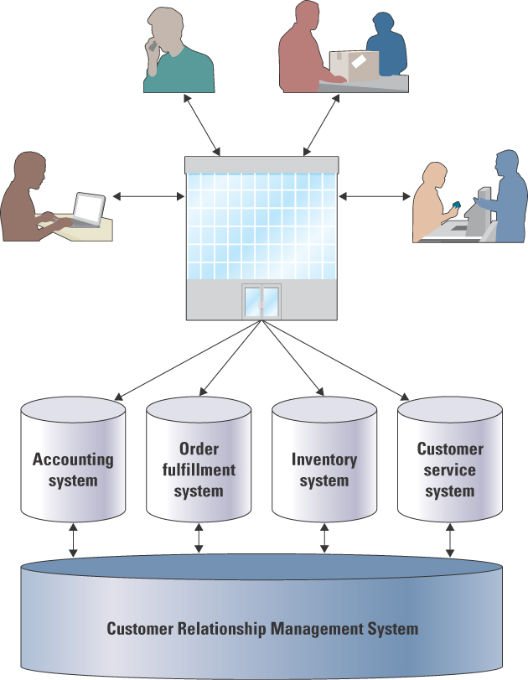


Customer Relationship Management
  Involves managing all aspects of a customer’s relationship with an organization to increase customer loyalty and retention and an organization's profitability
Benefits
  Identify types of customers
  Design individual marketing campaigns
  Treat each customer as an individual
  Understand customer buying behaviors
Notes:
CRM systems help organizations understand and manage their customers
Charles Schwab recouped the cost of a multimillion-dollar CRM system in less than two years
The system allowed Schwab to segment its customers in terms of serious and nonserious investors
The CRM system looked for customers that had automatic withdrawal from a bank account as a sign of a serious investor
The CRM system looked for stagnant balances as a sign of a nonserious investor
Charles Schwab could then focus efforts on selling to serious investors, and spend less time attempting to sell to nonserious investors
Organizations that use CRM to increase sales and improve operations
Ritz-Carlton Hotels
Harrah’s
Harley-Davidson

Slide 6
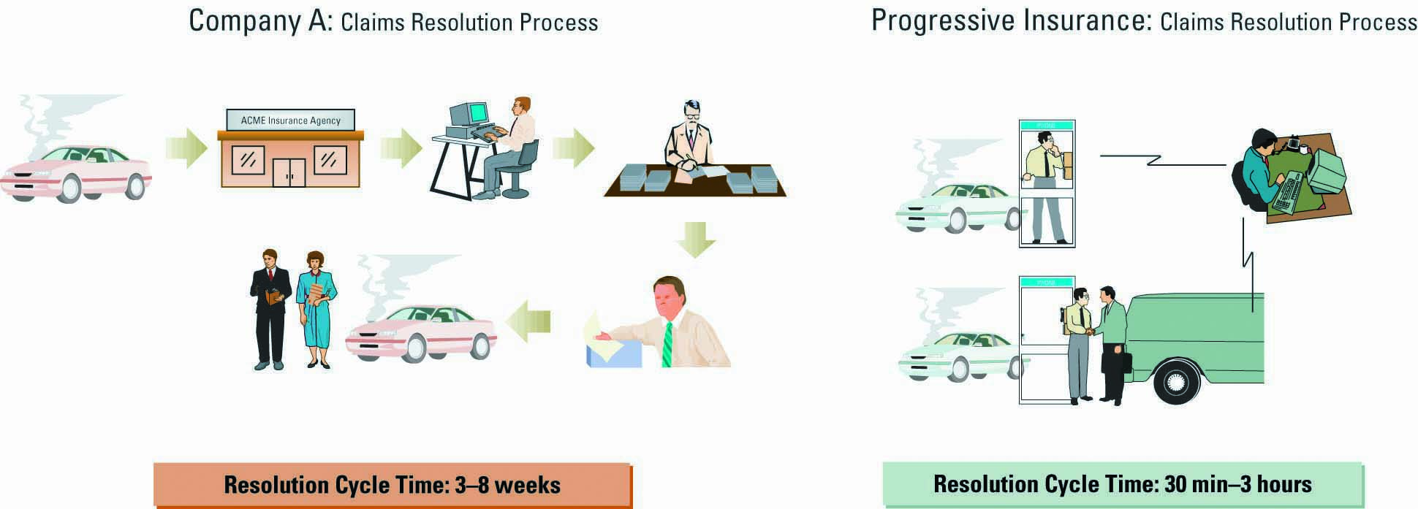
Business Process Reengineering
Business process
  a standardized set of activities that accomplish a specific task
  E.g. processing a customer’s order
Business process reengineering (BPR)
  the analysis and redesign of workflow within & between enterprises
  The purpose of BPR is to make all business processes best-in-class
3-6
Notes:
CLASSROOM EXERCISE
Reengineering a Process
There is nothing more frustrated than a broken process. Ask your students to break into groups and discuss examples of broken processes that are currently causing them pain. The process can be a university process, mail-order process, Internet-order process, return merchandise process, etc. Ask your students to agree on one of the broken processes and to reengineer the process. Students should diagram the “As-Is” process and then diagram their “To-Be” process. Bring in a large roll of brown package wrapping paper and masking tape. Give each group two large pieces of the paper and ask them to tape the paper to the wall. These make for great “As-Is” and “To-Be” process maps.

Slide 7
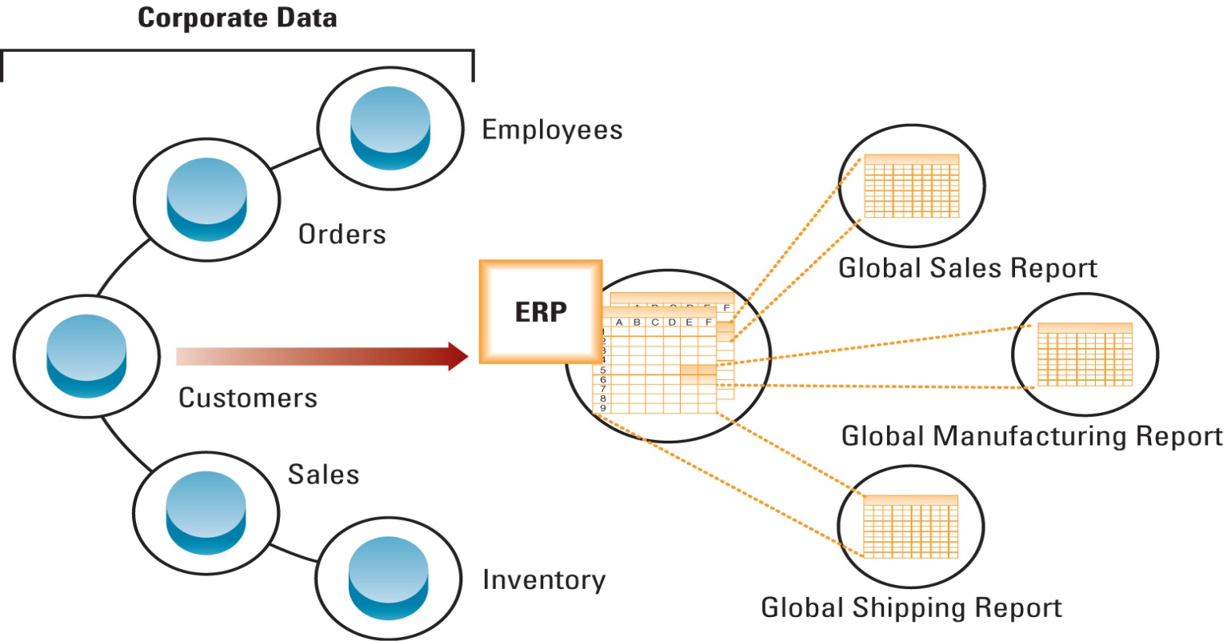
Enterprise Resource Planning
Integrates all departments and functions throughout an organization into a single IT system so that employees can make decisions by viewing enterprisewide information on all business operations
Notes:
What happens when sales and marketing departments are working from two different sets of customer information and product information?
Would the marketing campaigns be accurate?
Would sales be able to deliver the products it sells to its customers?
Briefly explain the differences between SCM, CRM, and ERP
SCM systems focus specifically on suppliers
CRM systems focus specifically on customers
ERP systems focus on everything, all processes, departments, and operations for an enterprise

Slide 8
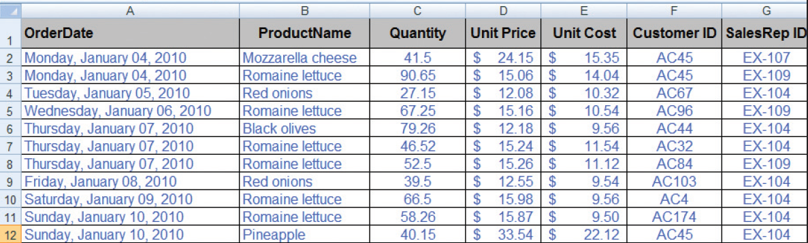
Sample data from a sales database
Notes:
When displaying the sales database example and the accounting database be sure to point out the differences in the data
Why correlating these two spreadsheets would be difficult?
How can you understand customers when one spreadsheet has customer name and one has customer ID?
How can you understand sales reps when one spreadsheet has sales rep names and one spreadsheet has sales rep ID?
Date format is different – will this cause problems?
One quantity is in units and one quantity has decimal points – what problems will this cause?
Unit price and unit cost is rounded to dollars in one spreadsheet and contains cents in another – what problems will this cause?

Slide 9
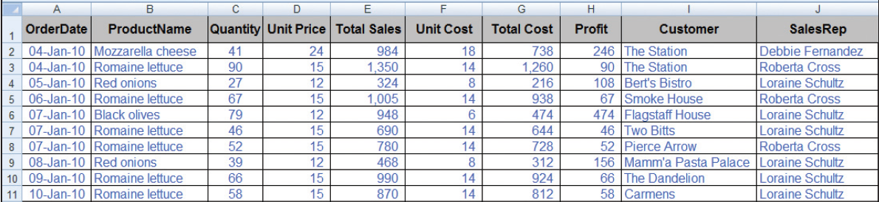
Sample data from an accounting database with ERP
3-9
Notes:
When displaying the sales database example and the accounting database be sure to point out the differences in the data
Why correlating these two spreadsheets would be difficult?
How can you understand customers when one spreadsheet has customer name and one has customer ID?
How can you understand sales reps when one spreadsheet has sales rep names and one spreadsheet has sales rep ID?
Date format is different – will this cause problems?
One quantity is in units and one quantity has decimal points – what problems will this cause?
Unit price and unit cost is rounded to dollars in one spreadsheet and contains cents in another – what problems will this cause?

Slide 10




